Slide 1
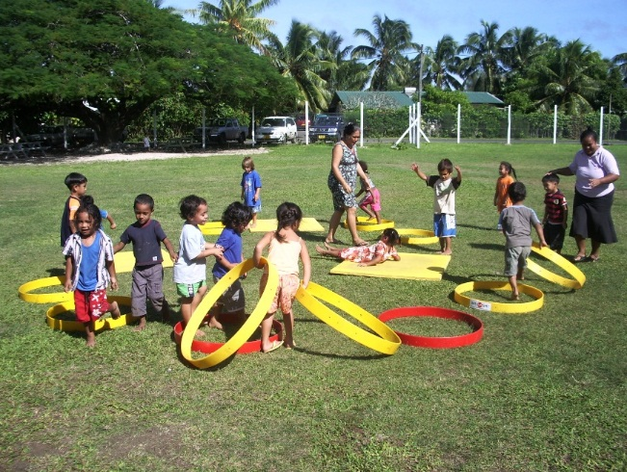
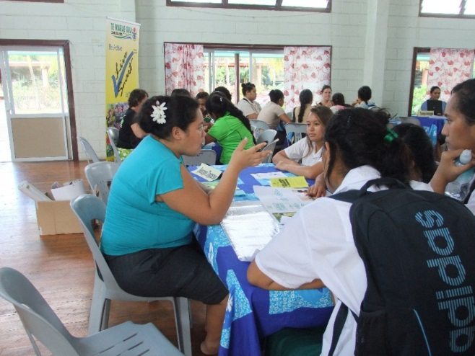
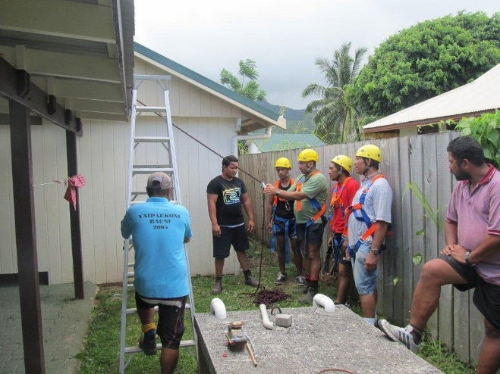
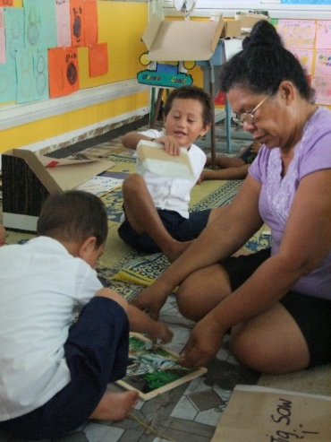
Education Sector Stakeholders’ Report 2012/13

Slide 2
Taku Ipukarea Kia Rangatira: The Achievements
Grade Four Maori Literacy:
2012 – 69% at or above national standard (2011: 58%, 2010: 56%)
Rarotonga improvement noticeable
Continued work on Maori resource development - new readers**
Maori language resourcing incentive to schools**
Continuation of Maori Language Week
NZQA Standards Development in Traditional Knowledge
Action research programme with teachers in schools – ECE, Literacy, ICT integration
UNESCO National Commission
Considerable regional and international involvement and requests for presentations
Notes:
Frances: to this slide add any Maori language courses you have done, specific Cook Island qualifications, tell me about conference presentations by your staff.

Slide 3
Taku Ipukarea Kia Rangatira: Challenges and Issues
Community perception around Maori Language
Some issues to be addressed around NCEA Level 1 Maori
Embedding and sustaining pedagogical change
Funding of National Commission for UNESCO

Slide 4
Taku Ipukarea Kia Rangatira: The Next Steps
Maori Language Teacher Training – Fast Track Initiative
Second Round of Participatory Programmes
Major EFA Reporting – the post 2015 Agenda
Increasing amount of action research – brings about change in pedagogy

Slide 5
Learning and Teaching: The Achievements
Literacy (English): 69% of Grade 4 at or above national standard in 2012 (73% in 2011). Level 1 Literacy tracking above 2015 targets.
Numeracy:71% at or above national standard in 2012 (68% in 2011). Specific training continues.
ECE – increasing roll numbers, high level of teacher participation in professional development. Strong collaboration with Te Kakaia programme. GER slightly decreased with change in entitlement.
NCEA Level 1 – National: 65%, Lit = 90%, Num = 86%
(Tracking: 2010 -49%, 2011:64%)
NCEA Level 2 – National: 76% (Tracking 2010-53%, 2011- 66%)
NCEA Level 3 – National: 71% (Tracking: 2010 – 55%, 2011:63%)
Te Kura Uira – considerable developments for 2014 academic year
Tertiary – redevelopment of tertiary sector. Funding maintained as a POBOC. London City and Guilds accreditation
Inclusive Education – embedding use of referral and diagnostic systems, development of assistive technology
Student Support – increase in counselling services, improving retention
Curriculum – review underway of Cook Islands Curriculum Framework

Slide 6
Learning and Teaching: Issues and Challenges
Increasing scope and accessibility of secondary and dual pathway programmes in a sustainable way
Provision of support to isolated schools
Network of specialists for children with specific needs

Slide 7
Learning and Teaching: The Next Steps
Focus in second language learning
ICT integration
Development of curriculum statements for revised Cook Islands Curriculum Framework
Continued increase of scope – subjects and programmes
Continued development of Guidance and Careers programmes
Implementation of Tertiary, Continuing and Community Education Strategy.

Slide 8
Learning and the Community: The Achievements

Slide 9
Learning and the Community: Issues and Challenges
Shifting mind sets on parental roles – especially at secondary school level
Critical mass of capacity in school committees

Slide 10
Learning and the Community: The Next Steps

Slide 11
Infrastructure and Support: The Achievements
Education Act (2012)

Slide 12
Infrastructure and Support: Issues and Challenges

Slide 13
Infrastructure and Support: The Next Steps

Slide 14
The Ministry of Education
The Ministry of Education values the unique nature of the Cook Islands. We contribute to the effective governance of our country and are recognised as leaders in education in the region.
The Ministry of Education provides a dynamic and professional environment which promotes and support life long learning through the provision of quality services.

